Slide 1

Jarvis – AI Voice Assistant using Python
Mohd Shehzad | University Roll No.: 2302612
Guru Nanak Dev Engineering College, Ludhiana
Training Organisation: THINKNEXT Technologies Pvt. Ltd.
Duration: 23rd June 2025 – 23rd July 2025

Slide 2

About the Training & ThinkNEXT Technologies
ThinkNEXT Technologies Pvt. Ltd.
Training Overview
Based in Mohali, Punjab, ThinkNEXT Technologies is a pioneer in advanced technology training. Their focus on practical, real-world projects sets them apart, preparing students for industry challenges.
This summer training honed my skills in Artificial Intelligence and Machine Learning. The program emphasised hands-on experience, transforming theoretical knowledge into functional applications using Python.

Slide 3



Project Objective: Building a Smart Assistant
Voice-Enabled Interaction
Real-Time Task Execution
Advanced AI Integration
Develop a Python-based assistant that understands and responds to spoken commands, providing a natural user experience.
Enable Jarvis to perform practical tasks like opening applications, providing information, and taking notes instantly.
Seamlessly integrate speech recognition, text-to-speech, and sentiment analysis for intelligent and adaptive responses.

Slide 4




Core Tools & Technologies
Python 3.10
Key Libraries
The primary programming language, offering a robust and versatile environment for AI and ML development.
SpeechRecognition
pyttsx3 (Text-to-Speech)
TextBlob (NLP)
scikit-learn (ML)
numpy (Numerical computing)
Development Environment
ML Models
VS Code for efficient coding and debugging, with CMD/Terminal for execution and output.
Leveraged Linear Regression for predictive capabilities, specifically for mark and house price estimations.

Slide 5

Key Features of Jarvis
Voice Command Recognition: Accurately interprets spoken instructions and maps them to predefined actions.
Text-to-Speech Responses: Generates clear, audible replies, making interactions natural and intuitive.
Sentiment Detection: Analyses the emotional tone of user input (happy, sad, neutral) to tailor responses.
Intelligent Note-Taking: Captures and saves spoken notes directly into a text file for easy retrieval.
Machine Learning Prediction: Utilises trained models to predict marks and house prices based on given data.

Slide 6
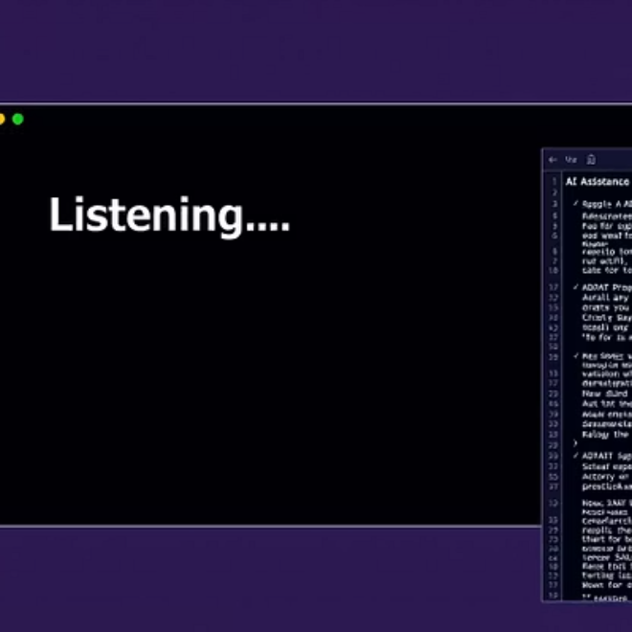
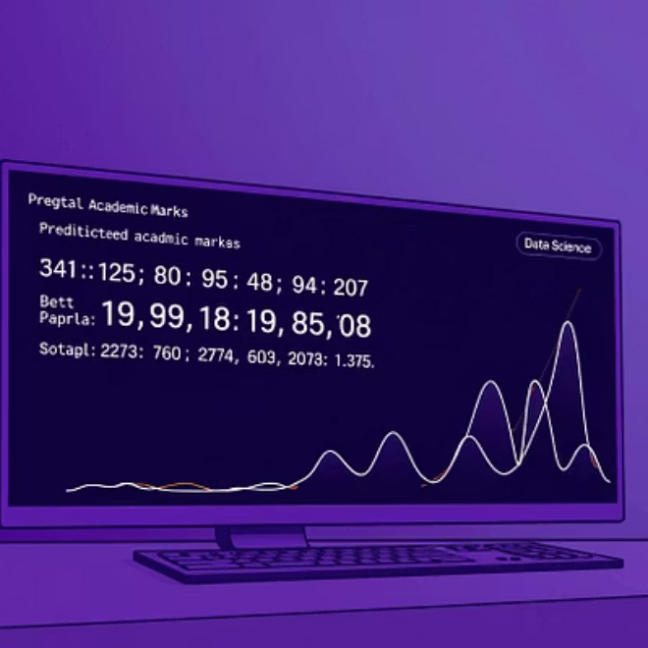
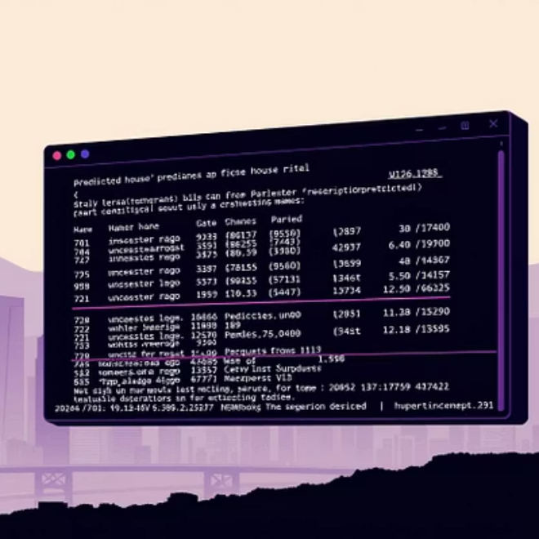
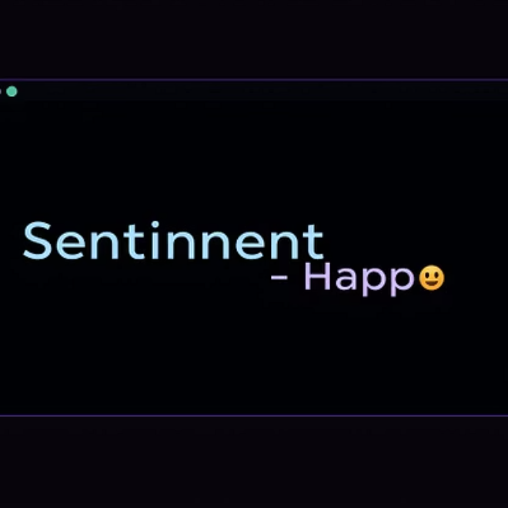
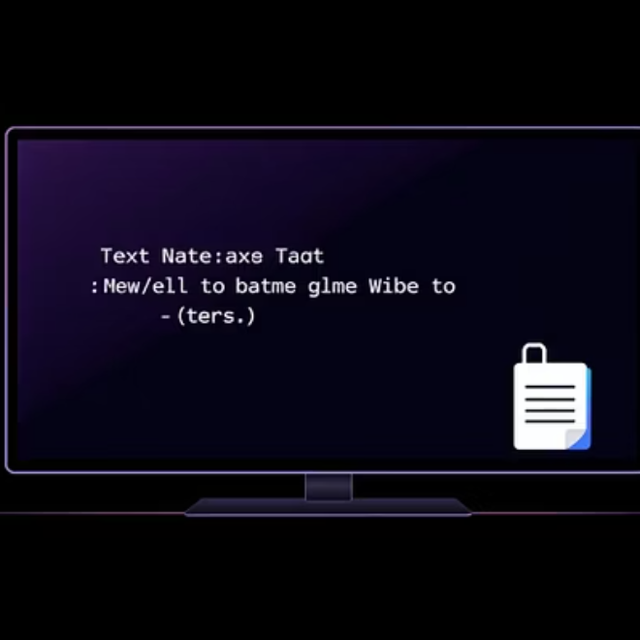
Jarvis in Action: Console Output Examples
These snippets illustrate Jarvis's real-time interaction capabilities, from voice command processing to machine learning predictions and file operations.

Slide 7



Overcoming Challenges & Solutions
Speech Accuracy
Integration Complexity
Real-Time Performance
Overcame background noise interference using advanced noise reduction techniques and fine-tuning speech recognition parameters.
Successfully integrated diverse Python libraries by modularising code and creating robust API connectors for seamless data flow.
Optimised algorithms and leveraged asynchronous programming to ensure Jarvis's responses and actions were instantaneous.
Each challenge presented an opportunity for deeper learning, leading to a more resilient and efficient AI assistant.

Slide 8
Future Enhancements for Jarvis
Advanced Natural Language Understanding
Smart Home Integration
Implement more sophisticated NLP models for contextual comprehension.
Control smart devices (lights, thermostats) via voice commands.
Enable multi-turn conversations and complex query processing.
Automate routine tasks based on user preferences and schedules.
Personalised User Profiles
Web Integration & API Calls
Store user preferences for tailored responses and actions.
Fetch real-time information from web APIs (weather, news, stock market).
Learn from user interactions to improve performance over time.
Perform web searches and summarise results directly through voice.

Slide 9
Key Learnings from the Project
AI & ML Practical Application
Library Integration Mastery
Applied theoretical AI and ML concepts to develop a functional voice assistant, witnessing their real-world impact.
Gained proficiency in seamlessly combining various Python libraries to build complex, interconnected systems.
Project Management & Confidence
Real-Time Interaction Design
Boosted confidence in handling diverse Python projects from conception to deployment, ready for future challenges.
Successfully engineered a system for instant voice recognition and response, enhancing user experience.

Slide 10

Thank You!
Questions & Discussion
I appreciate your time and attention. I am now open to any questions you may have regarding the Jarvis project or my training experience.

